Slide 1

Notes:
Tiitelleht

Slide 2

The Role of ENCB in standardisation
Jaak Jõesoo
Head of Technical Planning Department
16.09.2003, Tallinn

Slide 3
Structure for standardisation
ISO
IEC
ITU
CEN
CENELEC
ETSI
Communications Board
EVS
Ministry of Economic Affairs and Communication
Technical Board
Co-operation partners
Technical Committees

Slide 4
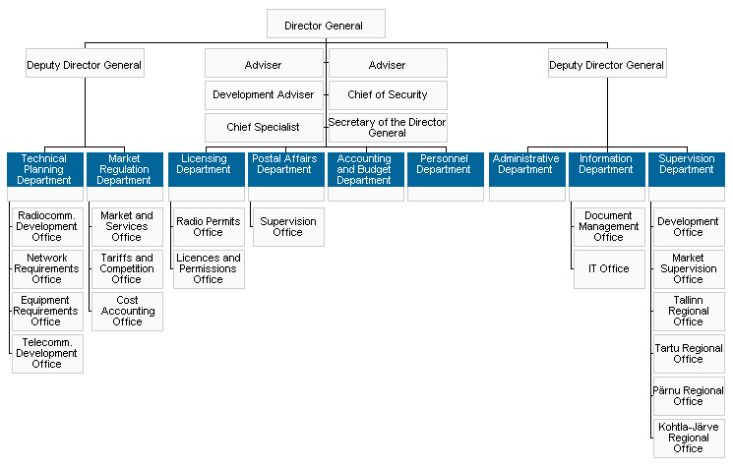
Structure

Slide 5

Short introduction
Inspection of Telecommunication was established in 1991 (since 1998 the Estonian National Communications Board)
1998-2000 the reorganization of structure into a regulator of telecommunication market
ENCB is ETSI member from 1998 (last version of MoU between ETSI and ENCB was signed in July, 2003)

Slide 6
Role of ENCB in national standardisation (1)
- Participartion in:
Technical Committees
TK3 -Telecommunication
TK4 - Information Technology
Technical (Advisory) Board
- Make proposal to National Standards Programme

Slide 7
Role of ENCB in European standardisation (2)
ETSI member in 2 categories:
Full member as Administration
  Responsible for the regulation of telecommunications and related areas in a country
Member as National Standards Organization Has exclusive responsibility in its country for a particular subject area for which ETSI is responsible

Slide 8
Participation in ETSI committees (1)
ERM – Technical Committee –Electromagnetic Compatibility and Radio Spectrum Matter
TC ERM is responsible for 75% of standards being developed under the Radio and Telecommunications Terminal Equipment (R&TTE) Directive (1999/5/EC).
Meetings are held three times per year

Slide 9
Participation in ETSI committees
TC meetings and documents are observed:
SPAN-Services and Protocols for Advanced Networks
STQ-Speech Processing, Transmission and Quality Aspects
TIPHON-Telecommunications and Internet Protocol Harmonization Over Network

Slide 10
Acting as NSO (1)
Public enquiry and voting
All drafts are published on our homepage for public discussion
Consolidated comments received in the public enquiry are sent to ETSI.
Establishes national position for the vote on draft EN and forwards it to ETSI

Slide 11
Acting as NSO (2)
Transposition and Withdrawal
Make proposal to:
National Standards Programme
Estonian Centre for Standardisation
Adoption ETSI standards as Estonian standards (agreement between Estonian Centre for Standardisation and ENCB, 15.10.2001)

Slide 12
Contact
Ädala 2, Tallinn, Estonia, 10614
Tel. +372 6 93 1154
Fax. +372 6 93 1155
www.sa.ee
E-mail postbox@sa.ee

Slide 13
Thank you for your attention

